Slide 1
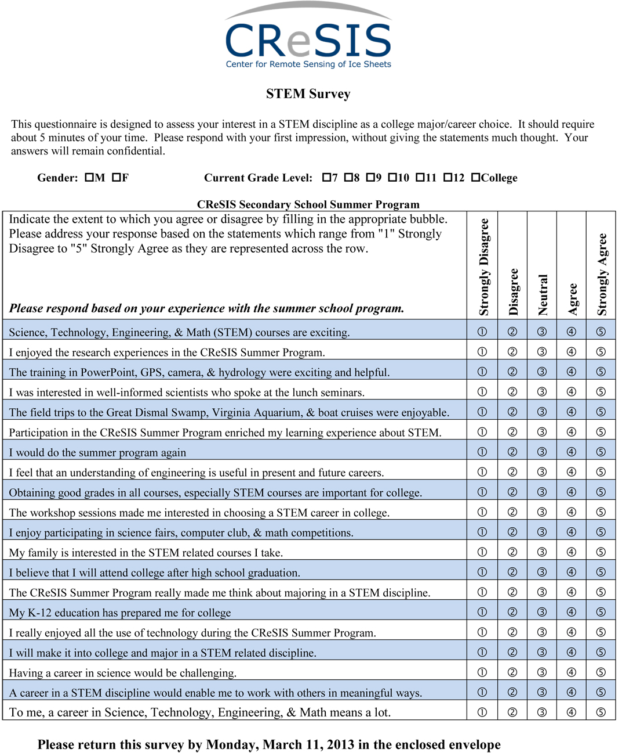
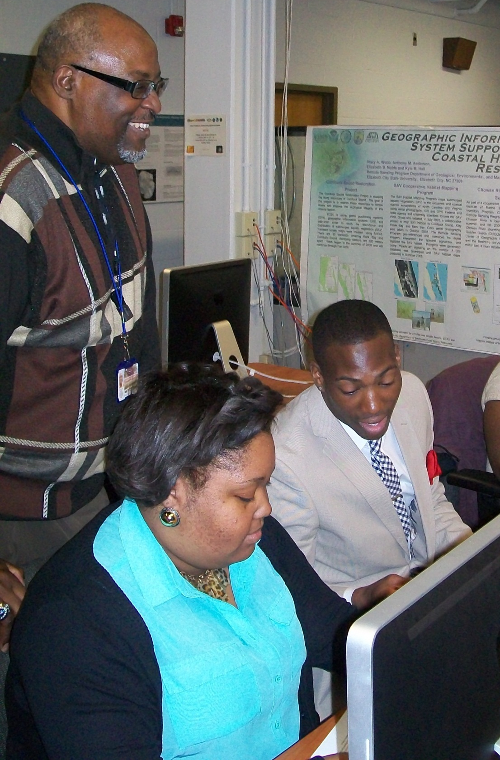
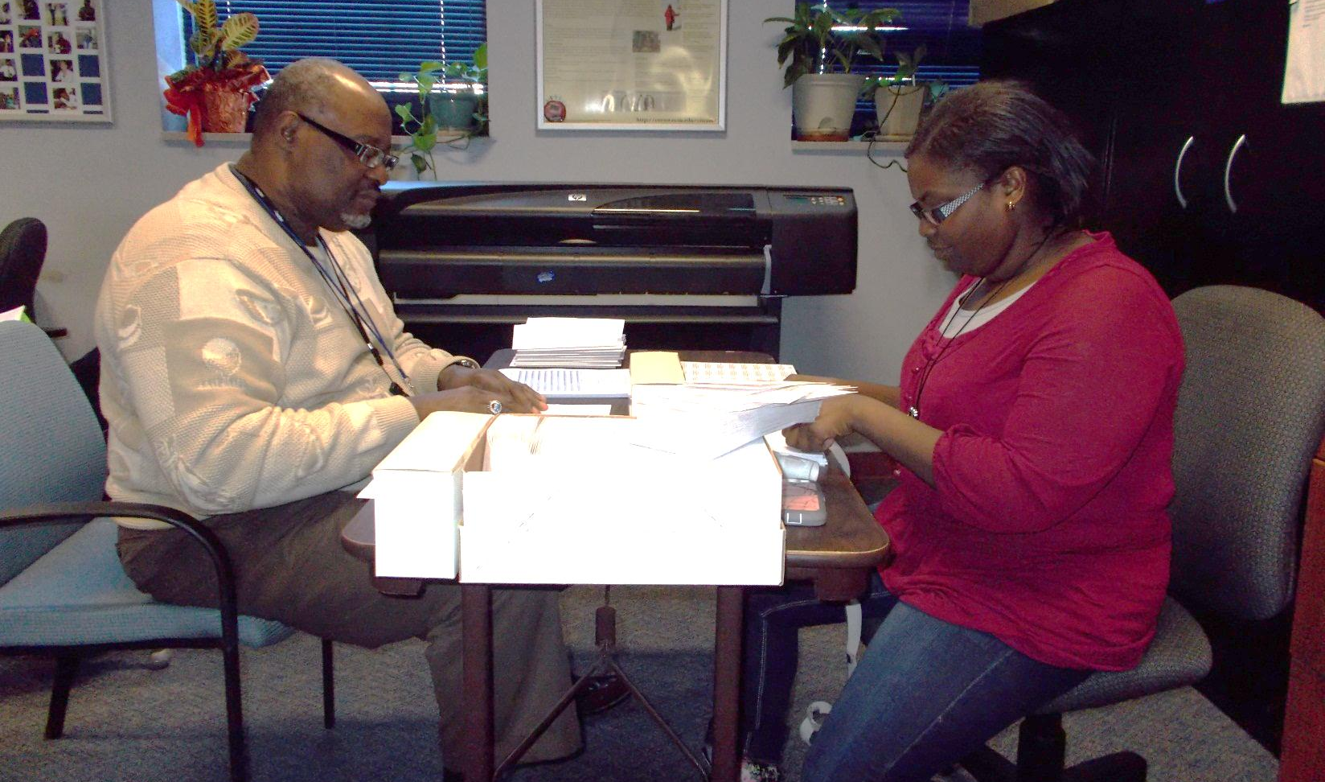
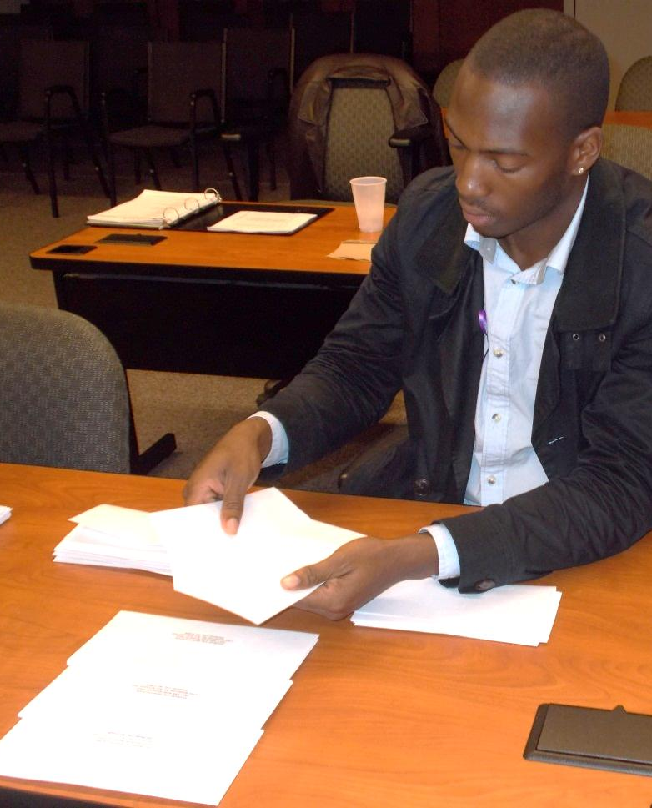
The Impact of 2006-2012 CReSIS Summer Research Programs that Influence Students’ Choice of a STEM Related Major In College
Alicia Reynolds, Jessica Hathaway, Courtney Farmer, Malcolm McConner (Elizabeth City State University ) Mentor: Dr. Darnell Johnson (Elizabeth City State University )
ABSTRACT
Researchers, policymakers, business, and industry have indicated that the United States will experience a future shortage of professionals in the Science, Technology, Engineering, and Mathematics (STEM) fields. Several strategies have been suggested to address this impending shortage, one of which includes increasing the representation of females and minorities in the STEM fields. In order to increase the representation of underrepresented students in the STEM fields, it is important to understand the motivational factors that impact underrepresented students’ interest in STEM academics and extracurricular programs. Research indicates that greater confidence leads to greater interest and vice versa (Denissen et al., 2007). In this paper, mathematics research team examined the role of practical research experience during the summer for talented minority secondary students studying in STEM fields. An undergraduate research mathematics team focused on the link between summer research and the choice of an undergraduate discipline. A Chi Square Statistical Test was used to examine Likert Scale results on the attitude of students participating in the 2006-2012 Center for Remote Sensing of Ice Sheets (CReSIS) Summer Research Programs for secondary students. This research was performed at Elizabeth City State University located in northeastern North Carolina about the factors that impact underrepresented students’ choices of STEM related majors in college. Results can be used to inform and guide educators, administrators, and policy makers in developing programs and policy that support and encourage the STEM development of underrepresented students.
SAMPLE AND PARTICIPANTS
The data collected and analyzed in this study is from the data collection that took place with students who participated in the 2006-2012 CReSIS Summer Research Programs at Elizabeth City State University. The participants in the summer programs consisted of 133 secondary school students from rural, urban and suburban northeastern North Carolina and urban Portsmouth, Virginia. 56 % of students responding were secondary school girls (n = _55_) and 44 % of students responding were secondary school boys (n = _43__) completed and returned the surveys for a 74 % response rate. Participants’ grades ranged from 7th grade to college with a median grade level was 11th grade for males and 10th grade for females. Human Subjects approval was granted for the initial data collection and follow up with the Elizabeth City State University Institutional Review Board indicated no further approval was needed for the data analysis in this study. A frequency distribution of participant demographic characteristics is reported in Table I below.
Table II. Five Liker-Type CReSIS Survey Question: “Impact of STEM on College Major”
 | Strongly Disagree/Disagree | Neutral | Strongly Agree/Agree
Science, Technology, Engineering, & Math (STEM) courses are exciting. | 0 | 4 | 94
My family is interested in the STEM related courses I take. | 3 | 1 | 94
I will make it into college and major in a STEM related discipline. | 1 | 4 | 93
A career in a STEM discipline would enable me to work with others in meaningful ways | 0 | 3 | 95
To me, a career in Science, Technology, Engineering, & Math means a lot. | 0 | 4 | 94
Table VI. Chi-square statistic calculated for each survey question
5.50580E-10 | 5.16869E-12 | 1.83725E-08 | 1.08184E-11
2.51135E-11 | 1.82438E-09 | 3.08154E-09 | 1.08184E-11
6.95077E-10 | 2.40174E-08 | 1.19673E-10 | 1.74411E-09
1.08991E-08 | 5.73724E-10 | 4.33474E-11 | 1.33238E-10
9.82298E-10 | 5.788861E-09 | 5.33211E-10 | 1.71341E-10
Table III. Five Likert-Type CReSIS Survey Questions: “Impact of CReSIS Summer Programs on College Major”
Chi-square Statistic was Calculated for each Survey Question
The Chi-Square Test showed a comparison of observed and expected values, which are listed above and concludes that the impact of the CReSIS Summer Program would be considered as a positive factor to influence students in this survey to choose a STEM related major in college. The significance level for all questions are less than 20% and conclude that males are independent of females in choosing STEM as a college major. The Chi Square indicates whether a statistically significant relationship exists.
 | Strongly Disagree/Disagree | Neutral | Strongly Agree/Agree
I enjoyed the research experiences in the CReSIS Summer Program | 0 | 0 | 98
Participation in the CReSIS Summer Program enriched my learning experience about STEM | 0 | 1 | 97
I would do the summer program again | 2 | 1 | 95
The CReSIS Summer Program really made me think about majoring in a STEM discipline | 1 | 3 | 94
I really enjoyed all the use of technology during the CReSIS Summer Program | 1 | 4 | 93
Table IV. Five Likert-Type CReSIS Survey Questions: “Impact of STEM Activities/Labs on College Major”
 | Strongly Disagree/Disagree | Neutral | Strongly Agree/Agree
The training in PowerPoint, GPS, camera, & hydrology were exciting and helpful. | 1 | 1 | 96
I was interested in well-informed scientists who spoke at the lunch seminars. | 1 | 5 | 92
The field trips to the Great Dismal Swamp, Virginia Aquarium, & boat cruises were enjoyable. | 0 | 5 | 93
The workshop sessions made me interested in choosing a STEM career in college. | 1 | 8 | 89
Table I. Frequency Distribution for Participant Demographics
CONCLUSION
After analyzing our data it was concluded that the students who participated in the CReSIS Summer Programs through the years 2006-2012 were positively impacted. The CReSIS program has done an effective job exposing underserved students to STEM related fields. CReSIS will continue to support secondary students and preparing them for the rigorous, yet engaging content of science, technology, engineering and mathematics. Future CReSIS programs will contribute to encourage students in their pursuit of a major and career in STEM.
Grade Level | 7 | 8 | 9 | 10 | 11 | 12 | College
Male | 1 | 4 | 5 | 9 | 12 | 8 | 4
Female | 2 | 8 | 14 | 12 | 8 | 4 | 7
Total | 3 | 12 | 19 | 21 | 20 | 12 | 11
Table V. Five Likert-Type CReSIS Survey Questions: “Impact of STEM Curriculum on College Major”
 | Strongly Disagree/Disagree | Neutral | Strongly Agree/Agree
I feel that an understanding of engineering is useful in present and future careers. | 2 | 4 | 92
Obtaining good grades in all courses, especially STEM courses are important for college. | 0 | 1 | 97
I enjoy participating in science fairs, computer club, & math competitions. | 1 | 8 | 89
I believe that I will attend college after high school graduation. | 0 | 1 | 97
My K-12 education has prepared me for college. | 2 | 3 | 93
Having a career in science would be challenging. | 1 | 0 | 97
PURPOSE
The purpose of this study was to explore the factors that influence underrepresented students’ choice of Science, Technology, Engineering, and Mathematics (STEM) related majors in college. The math team analyzed data from the 2006-2012 Center for Remote Sensing of Ice Sheets (CReSIS) Summer Research Programs for secondary students at Elizabeth City State University provided by the STEM assessment survey. Understanding the factors that influence underserved students’ interest in STEM will inform strategies that may potentially increase participation in these areas for this population.
SURVEY INSTRUMENT
The 2013 undergraduate research experience (URE) mathematics team conducted a needs assessment for the 2006-2012 CReSIS summer outreach program. The team faculty mentor met with a team of researchers to discuss the outreach program’s history and purpose for the STEM assessment. The information gained from the needs assessment was used to inform decisions regarding the educational outreach activities conducted by the URE math team that was directed toward the impact of the exploration of STEM related fields by underrepresented students. With content input from the faculty mentor, the URE math team designed the 20-item paper survey instrument (Appendix A) used for data collection with the secondary students that attended the CReSIS summer outreach program.
The survey instrument consists of only 1 part. This section was titled School math and science classes, inquires about the attitude of the math and science classes participants are taking, the feelings of the parents for or against the math and science classes, asking participants about their experiences in their math and science classes relative to teaching factors (e.g., my teacher encourages makes learning math/science fun), and the future careers associated with majoring in STEM related fields. In these 20 questions, participants were asked to select their level of agreement with each of the statements first for their math class and second for their science class with 1 = strongly disagree, 2 = disagree, 3 = neutral, 4 = agree, and 5 = strongly agree.
FOCUS QUESTIONS
What is the impact of students participating in STEM courses in the choice of college majors?
What is the impact of students participating in CReSIS Summer Program in the choice of college majors?
What is the impact of students participating in STEM activities/labs in the choice of college majors?
What is the impact of students using STEM curriculum in the choice of college majors?
FUTURE WORK
The future research will focus on tracking the progress of the underrepresented students that participated in the 2006-2012 CReSIS Summer Programs and who are currently enrolled in college. Data will be collected concerning their choice of college and major; further reflecting the impact of their involvement in CReSIS programs and STEM activities. Information sharing with CReSIS partners and the boarder community of these findings.
ACKNOWLEDGEMENTS
The 2013 URE Math Team would like to thank:
CERSER Principal Investigator: Dr. Linda B. Hayden
Mentor: Dr. Darnell Johnson
Students that participated in the CReSIS summer programs past, present and future
REFERENCES
Bottoms, G., & Uhn, J., (2001). Research Brief: Project Lead the Way works: A new typeof career and technical program. Southern Regional Education Board. Atlanta, GA.
Bronfenbrenner, U., (2005). Making human beings human: Bioecological Perspectives on human development. Thousand Oaks, CA: Sage Publications, Inc
Denissen, J.J., Zarrett, N.R., & Eccles, J.S. (2007). I like to do it, I’m able, and I know I am: Longitudinal couplings between domain-specific achievement, self-concept, and interest. Child Development, 78(2), 430-447
Freeman, R.B., (2005). Does globalization of the scientific/engineering workforce threaten U.S. economic leadership? Cambridge, MA: National Bureau of Economic Research
Green, S.B., & Salkind, N.J. (2008). Using SPSS for windows and macintosh: Analyzing and understanding data (5th ed.). Upper Saddle River, NJ: Pearson Prentice Hall.
Jeffers, A., Safferman, A., & Safferman, S. (2004). Understanding K-12 engineering outreach programs. Journal of Professional Issues in Engineering Education and Practice, 130(2), 95-108
National Center for Education Statistics, National Assessment of Educational Progress, Science Assessments (2000). U.S. Department of Education. Retrieved from http://nces.ed.gov/nationsreportcard/pdf/main2000/2002452.pdf
National Science Board (2010). Science and Engineering Indicators 2010. (NSB-10- 01). Arlington, VA: National Science Foundation
Rising Above the Gathering Storm. N.p.: National Academies, 2010. Print.
Rose, Andresse St. "OCWW | Vol 39, Issue 1 | Features." OCWW | Vol 39, Issue 1 | Features. Association of American Colleges and Universities, 2013. Web. 09 Apr. 2013.
Wallace, J.E., & Haines, V.A. (2004). The benefits of mentoring for engineering students. Journal of Women and Minorities in Science and Engineering, 10, 594-597

